Slide 1

Crash course on network analysis
A. Jarynowski, J.K. Ochab
Jagiellonian University, Cracow, Poland
Bootcamp on quantitative methods in L2 research
10-15 June 2019, Institute of Applied Linguistics, University of Warsaw
*Some copyrighted material inside – do not publish in WWW.

Slide 2
Outline
Types of graphs & representation
Examples
Sociologist’s viewpoint
Network structures, centrality, community detection
Data collection

Slide 3
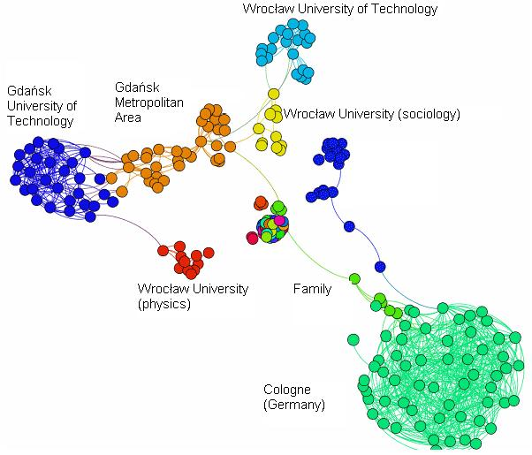
Notes:
Już niemożliwe do ściągnięcia z fb

Slide 4
Network types and representations

Slide 5
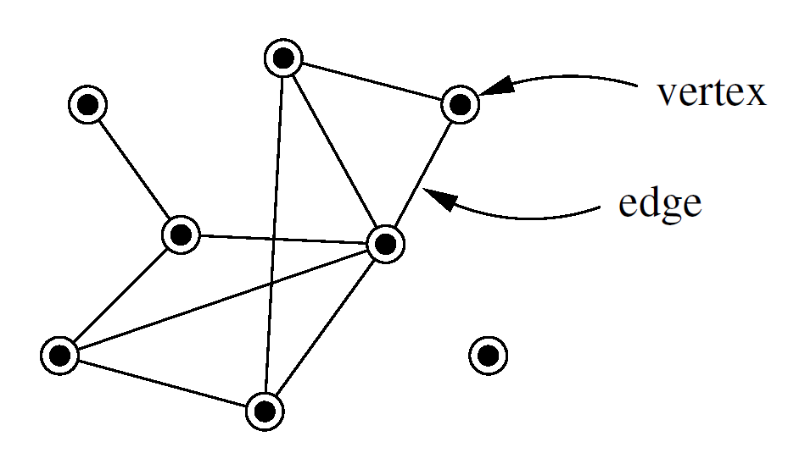
Types of graphs/networks
Entities (vertices/nodes)
Relations (edges/links)
MEJ Newman, The Structure and Function of Complex Networks, SIAM REVIEW 45 (2003) 167–256

Slide 6
Types of graphs
Entities (vertices/nodes)
Relations (edges/links)
Component
MEJ Newman, The Structure and Function of Complex Networks, SIAM REVIEW 45 (2003) 167–256

Slide 7
Types of graphs
d=1
Entities (vertices/nodes)
Relations (edges/links)
Component
Degree
d=3
d=0
MEJ Newman, The Structure and Function of Complex Networks, SIAM REVIEW 45 (2003) 167–256
Notes:
Opisz: degree

Slide 8
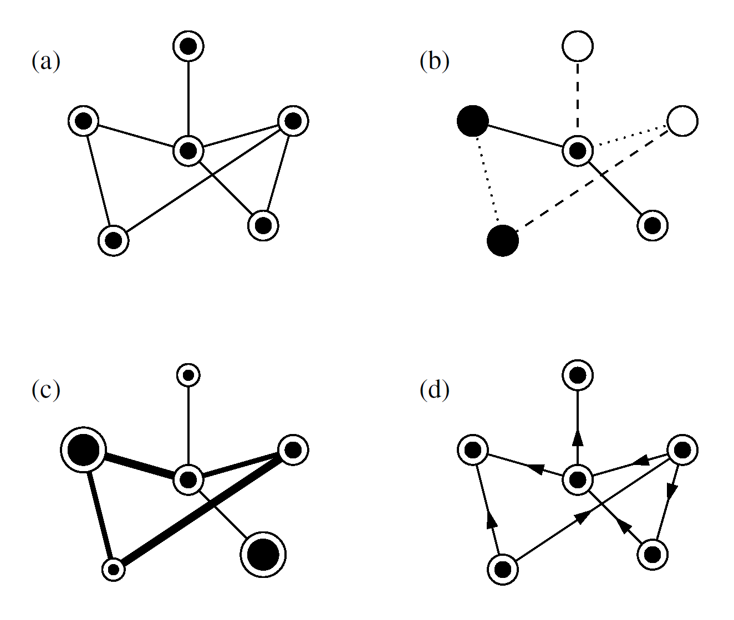
Types of graphs
simple (undirected)
multi-edge, multi-vertex type
weighted
directed
MEJ Newman, The Structure and Function of Complex Networks, SIAM REVIEW 45 (2003) 167–256

Slide 9
Types of graphs
Networks:
social
information
technological
biological
MEJ Newman, The Structure and Function of Complex Networks, SIAM REVIEW 45 (2003) 167–256
Notes:
Business interrelations, Citation network, Electric power grid, gene regulatory networks

Slide 10
Representations: adjacency matrix
1
2 4
3
5 6
MEJ Newman, The Structure and Function of Complex Networks, SIAM REVIEW 45 (2003) 167–256
Notes:
Matrices just as the similarity of texts in stylo

Slide 11
Representations: adjacency matrix
 |  | 1
1
1
2 4
3
5 6
MEJ Newman, The Structure and Function of Complex Networks, SIAM REVIEW 45 (2003) 167–256

Slide 12
Representations: adjacency matrix
 |  | 1
 |  | 1 |  | 1
1 | 1 |  | 1 |  | 1
 |  | 1 |  | 1 | 1
 | 1 |  | 1
 |  | 1 | 1
1
2 4
3
5 6
MEJ Newman, The Structure and Function of Complex Networks, SIAM REVIEW 45 (2003) 167–256

Slide 13
Representations: adjacency matrix
0 | 0 | 1 | 0 | 0 | 0
0 | 0 | 1 | 0 | 1 | 0
1 | 1 | 0 | 1 | 0 | 1
0 | 0 | 1 | 0 | 1 | 1
0 | 1 | 0 | 1 | 0 | 0
0 | 0 | 1 | 1 | 0 | 0
1
2 4
3
5 6
MEJ Newman, The Structure and Function of Complex Networks, SIAM REVIEW 45 (2003) 167–256

Slide 14
Representations: adjacency matrix
 |  | 1
 |  | 1 |  | 1
1 | 1 |  | 1 |  | 1
 |  | 1 |  | 1 | 1
 | 1 |  | 1
 |  | 1 | 1
1
2 4
3
5 6
 |  | 0
 |  | 1 |  | 1
1 | 1 |  | 1 |  | 1
 |  | 1 |  | 1 | 1
 | 1 |  | 1
 |  | 1 | 1
1
2 4
3
5 6
MEJ Newman, The Structure and Function of Complex Networks, SIAM REVIEW 45 (2003) 167–256

Slide 15
Representations: adjacency matrix
 |  | 1
 |  | 1 |  | 1
1 | 1 |  | 1 |  | 1
 |  | 1 |  | 1 | 1
 | 1 |  | 1
 |  | 1 | 1
1
2 4
3
5 6
1 | 1
 |  | 1 |  |  | 1
 | 1 |  | 1
 |  | 1
1
2 4
3
5 6
MEJ Newman, The Structure and Function of Complex Networks, SIAM REVIEW 45 (2003) 167–256

Slide 16
Representations: adjacency matrix
 |  | 1
 |  | 1 |  | 1
1 | 1 |  | 1 |  | 1
 |  | 1 |  | 1 | 1
 | 1 |  | 1
 |  | 1 | 1
1
2 4
3
5 6
 |  | 1
 |  | 3 |  | 2
1 | 3 |  | 2 |  | 1
 |  | 2 |  | 3 | 1
 | 2 |  | 3
 |  | 1 | 1
1
2 4
3
5 6
MEJ Newman, The Structure and Function of Complex Networks, SIAM REVIEW 45 (2003) 167–256

Slide 17
Representations: edge list
1
2 4
3
5 6
 | Nodes
Nodes |  |  | 1
 |  |  | 1 |  | 1
 | 1 | 1 |  | 1 |  | 1
 |  |  | 1 |  | 1 | 1
 |  | 1 |  | 1
 |  |  | 1 | 1
Edges
1-3
2-3
2-5
3-4
3-6
4-5
4-6
MEJ Newman, The Structure and Function of Complex Networks, SIAM REVIEW 45 (2003) 167–256
Notes:
Also incidence matrix

Slide 18
Network Examples

Slide 19
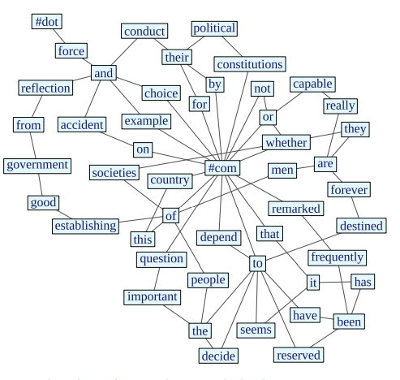
Co-occurence networks
Stanisz T, Kwapień J, Drożdż S (2019). Linguistic data mining with complex networks: A stylometric-oriented approach,
Information Sciences, 482, 301-320. Newman ME (2006). Finding community structure in networks using the eigenvectors of matrices. Phys. Rev .E 74, 036104.
Notes:
Connected to N-grams.

Slide 20
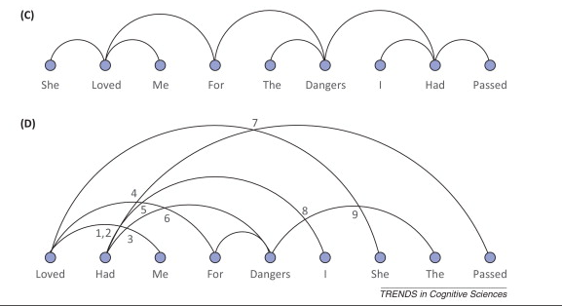
Dependency networks
Baronchelli A, Ferrer-i-Cancho R, et al. (2013) Networks in Cognitive Science. Trends in Cognitive Sciences 17, pp. 348-360.
Notes:
Chińczyk, dependency network : languan

Slide 21
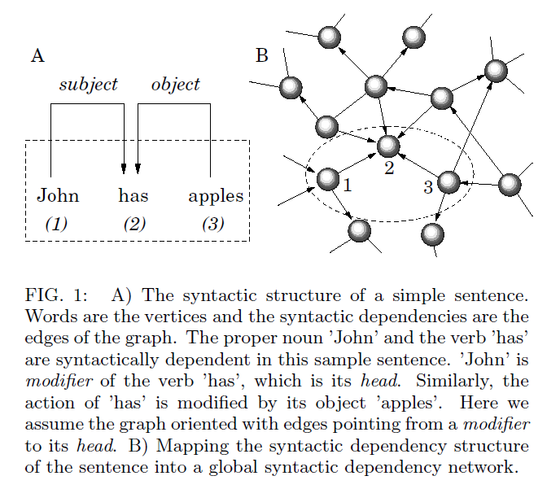
Dependency networks
Ferrer-i-Cancho R, et al. (2007). Spectral methods cluster words of the same class in a syntactic dependency network. International Journal of Bifurcation and Chaos, 17(07), 2453-2463.
Notes:
Chińczyk, dependency network : languan

Slide 22
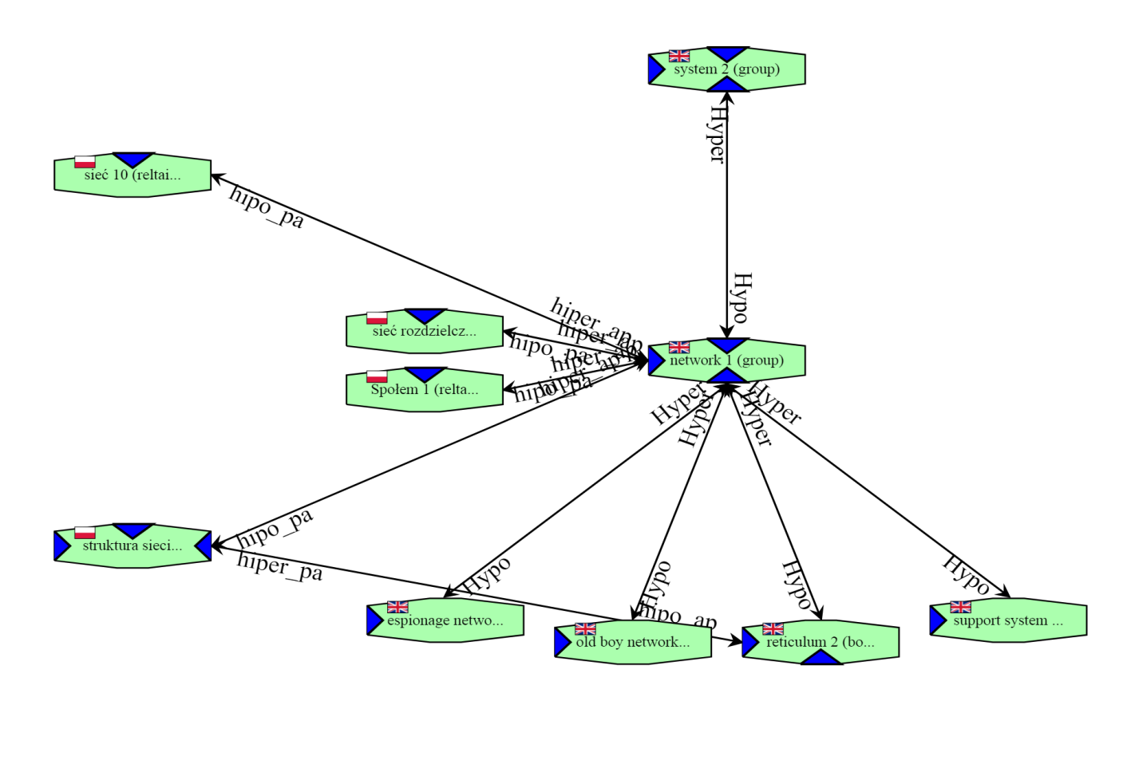
Semantic networks
Piasecki M, Maziarz M, Marcińczuk M, et al. (2010) WordNet, CLARIN-PL digital repository, http://hdl.handle.net/11321/29.
http://plwordnet.pwr.wroc.pl

Slide 23
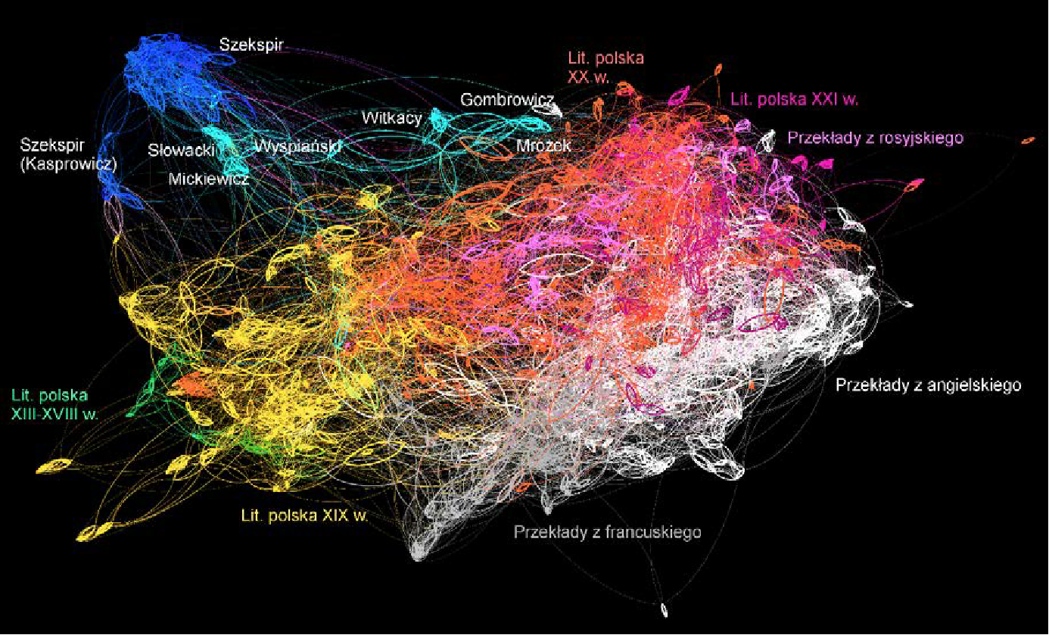
Text similarity networks
Rybicki J (2017) Drugi rzut oka na stylometryczną mapę literatury polskiej. Forum Poetyki 10: 6-21 Eder, M. (2015). Visualization in stylometry: cluster analysis using networks. Digital Scholarship in the Humanities, 30

Slide 24
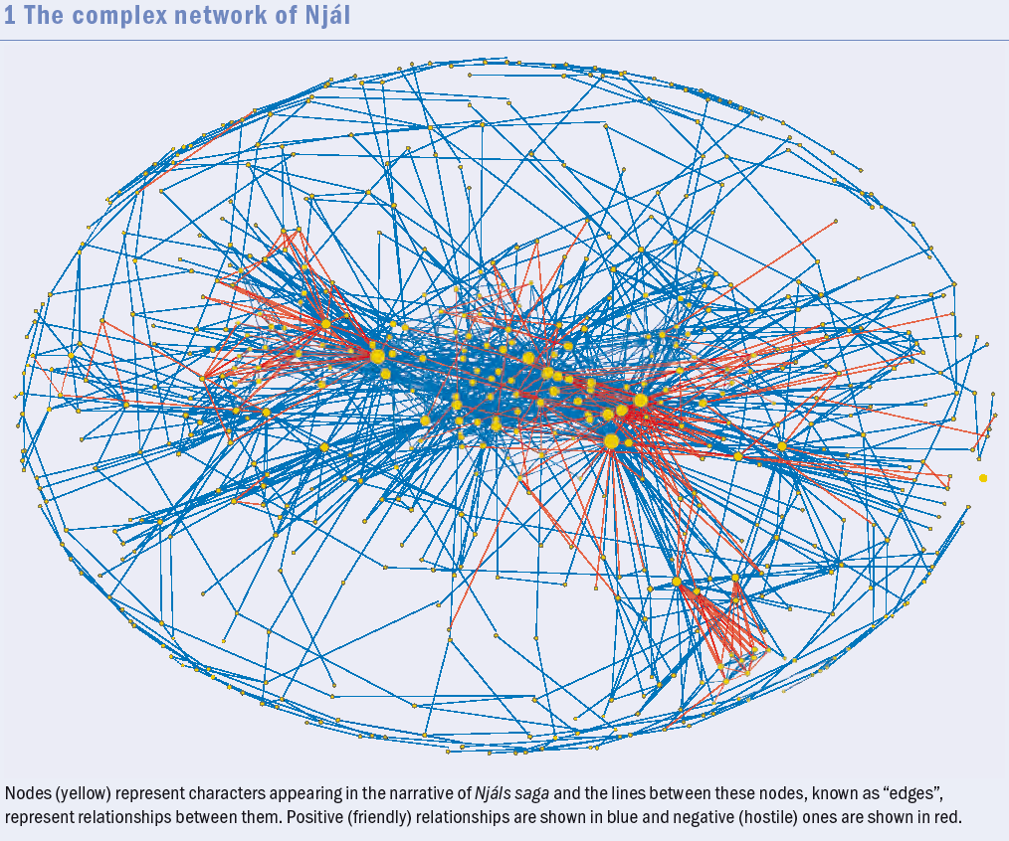
Literary character networks
Kenna, R. and MacCarron, P. (2016) Maths meets myths. Physics World, volume 29 (6): 22-27

Slide 25
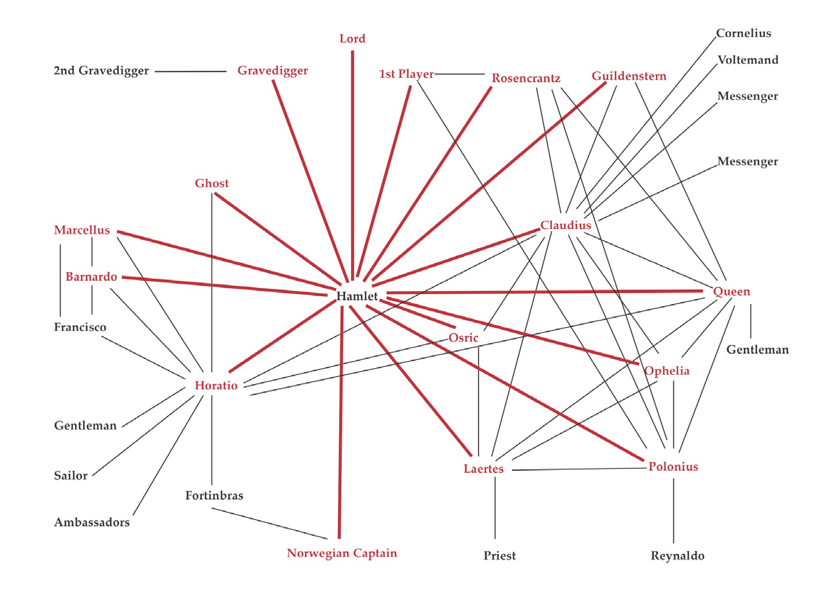


Literary character networks
Moretti F. 'Network Theory, Plot Analysis'. Web: (http://litlab.stanford.edu/LiteraryLabPamphlet2A.Text.pdf)

Slide 26
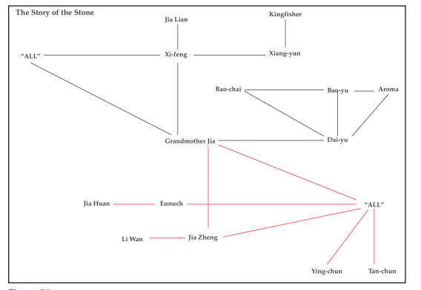
Literary character networks
Moretti F. 'Network Theory, Plot Analysis'. Web: (http://litlab.stanford.edu/LiteraryLabPamphlet2A.Text.pdf)

Slide 27
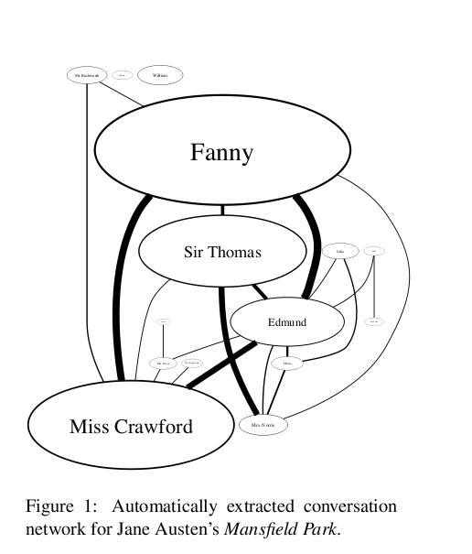
Conversational networks
Elson, DK, Dames, N, & McKeown, KR (2010). Extracting social networks from literary fiction. In Proceedings of the 48th annual meeting of the association for computational linguistics (pp. 138-147). Association for Computational Linguistics.
Notes:
→ Mansfield park network, with 'social network' defined as conversational network.
→ Conversation, where characters take turns speaking, mutually aware of each other and intending the other to hear.
→ Size of bubble indicates how often character mentioned
→ line thickness indicates signifiance of interaction
→ One of the things we get from a literary perspective is that significant doesn't necessarily mean important; and this is something we chose to examine further.

Slide 28
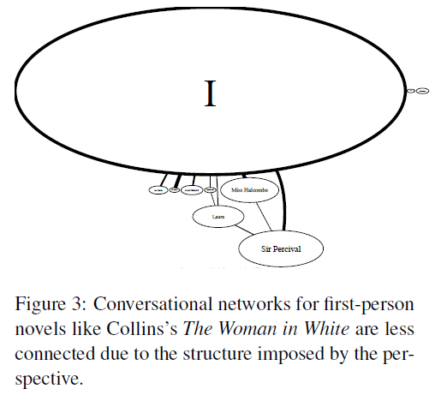
Conversational networks
Elson, DK, Dames, N, & McKeown, KR (2010). Extracting social networks from literary fiction. In Proceedings of the 48th annual meeting of the association for computational linguistics (pp. 138-147). Association for Computational Linguistics.

Slide 29
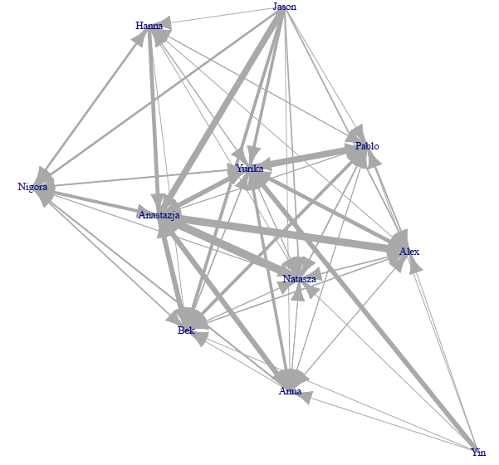
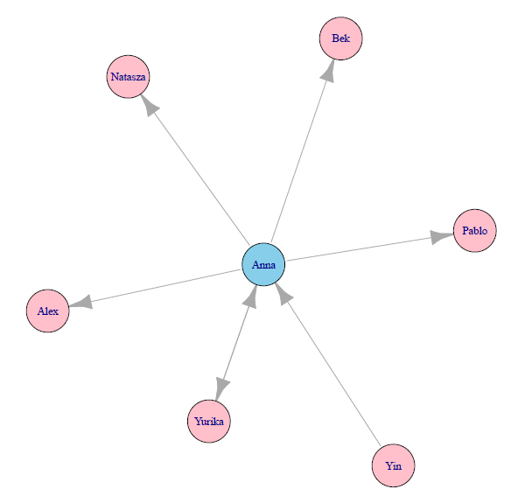
Sociograms of L2 learners

Slide 30
A Sociologist’s viewpoint

Slide 31
Node = individual components of a network e.g. people, world, characters, etc.
Edge = direct link between components (referred to social networking as a relationship between two people); dependencies and relationships between words

Slide 32
Regular 'grid' topology
Random networks (ER, WS, BA)

Slide 33
Comunication schema:
sender – message – receiver
Moreno Sociograms:
- Network of Power – topological centralities
- Comunication Network – flow of information
Social Roles: hub, brigde-brokers, outliers
Social Motives: triangle closure, N-triangles, cliques, communities

Slide 34
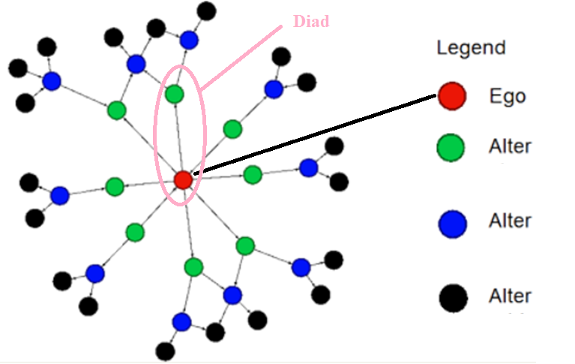
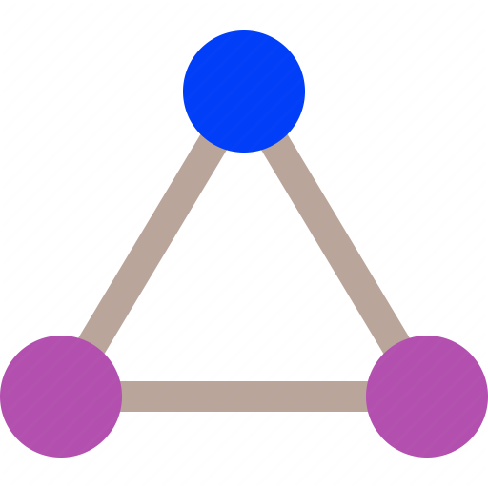
Triangle
Sociological theories (structuralism, small world effect, homophily, information flow, socialization, social norms, weak ties, triangle closure, etc.)
Psychological theories (dyads, social influence, etc.)
Economic theories (game theory, exchange theory, St. Mathew effect, etc.)
Antrophological/ethnographical theries (social animal, functional theory, altruism, magical thinking, etc.)
Political science (external field, role of media, etc.)

Slide 35
Network structure and measures

Slide 36
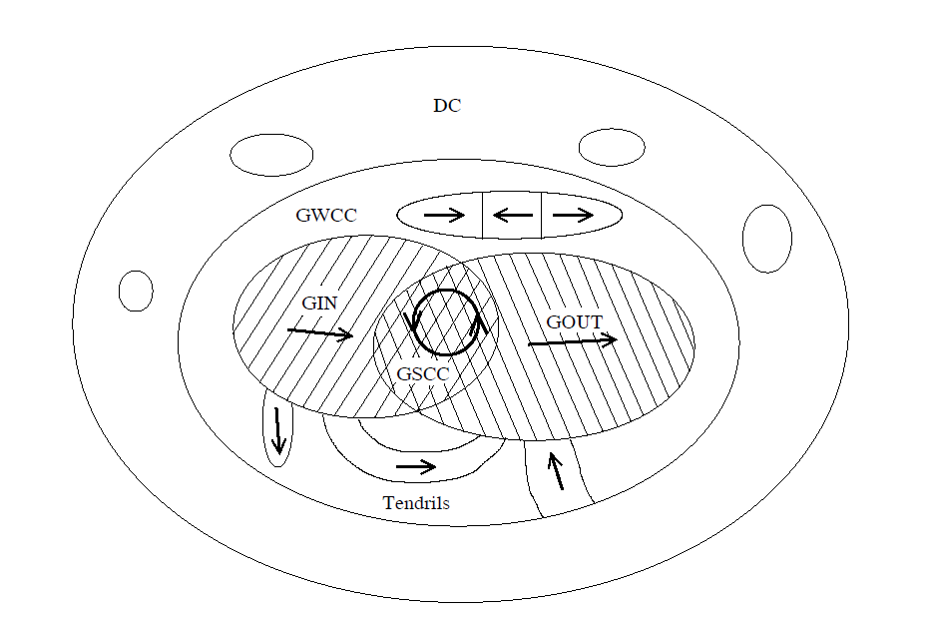
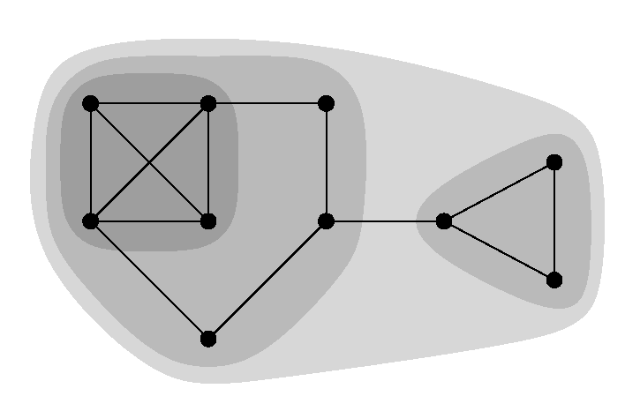
Network structures
(W/S)CC=(weakly/strongly) connected component
core-periphery
SN Dorogovtsev, JFF Mendes, Evolution of networks, Advances in Physics, 51:4 (2002) 1079-1187
MEJ Newman, Networks, An Introduction (2010) Oxford University Press
Notes:
Direction of information transfer
Do we have information transfer in linguistic networks -> markov model

Slide 37
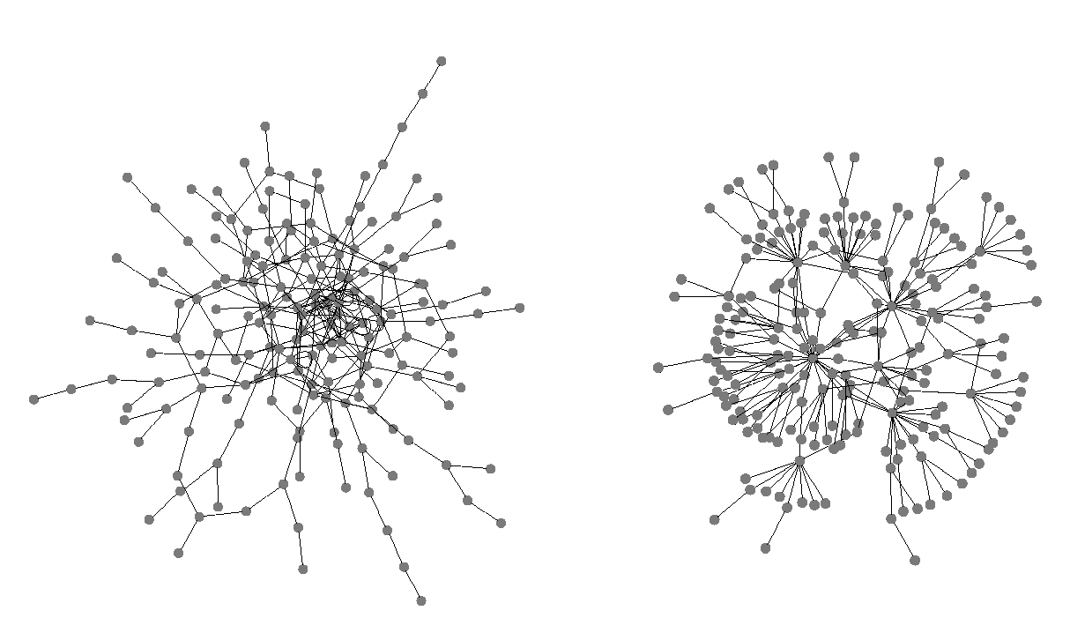
Network structures
Assortative Disassortative
MEJ Newman, Networks, An Introduction (2010) Oxford University Press

Slide 38
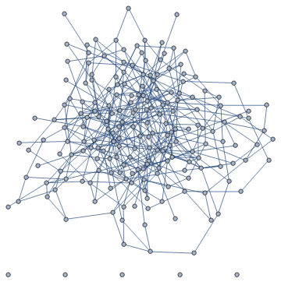
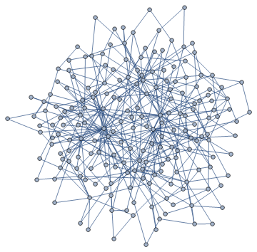
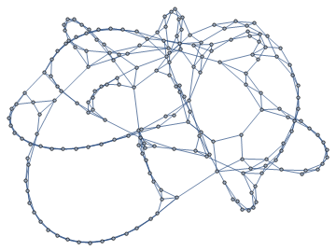
Network models
Random Scale-free Small-world
S. Milgram (1967) The small world problem, Psychology Today 2, pp. 60-67
Notes:
Modele do testowania własności sieci prawdziwych

Slide 39
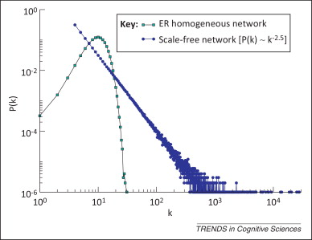
Network models
Random Scale-free
Barabási AL, Albert R (1999). Emergence of scaling in random networks. Science 286 (5439), 509-512. Baronchelli A, Ferrer-i-Cancho R, et al. (2013) Networks in Cognitive Science. Trends in Cognitive Sciences 17, pp. 348-360.
Notes:
Modele do testowania własności sieci prawdziwych

Slide 40
Centrality measures
How „important” is a node/link?
degree
clustering
closeness
betweenness
…
MEJ Newman, The Structure and Function of Complex Networks, SIAM REVIEW 45 (2003) 167–256

Slide 41
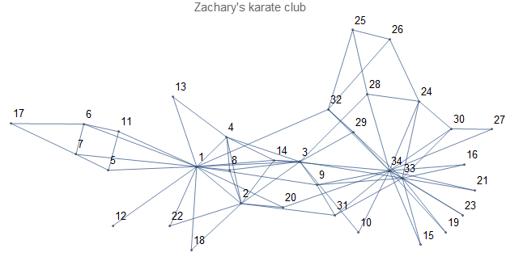
Centrality measures
How „important” is a node/link?
degree
clustering
closeness
betweenness
…
MEJ Newman, The Structure and Function of Complex Networks, SIAM REVIEW 45 (2003) 167–256

Slide 42
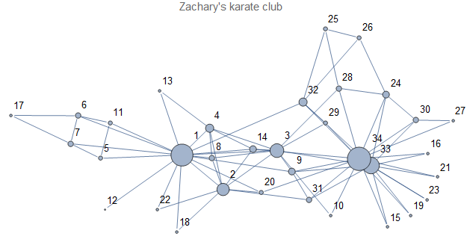
Centrality measures
How „important” is a node/link?
degree
clustering
closeness
betweenness
…
MEJ Newman, The Structure and Function of Complex Networks, SIAM REVIEW 45 (2003) 167–256

Slide 43
No connections
between nodes
Some nodes connected
All relevant nodes connected
c = 0
c = 1/3
c = 1
Clustering coefficient counts number of triangles in networks

Slide 44
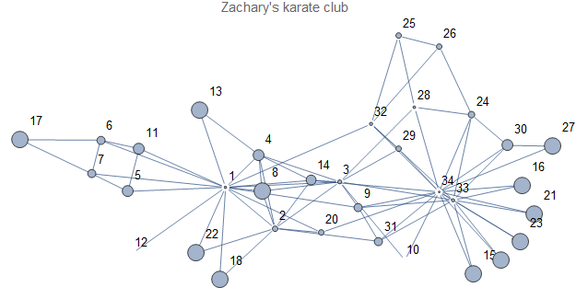
Centrality measures
How „important” is a node/link?
degree
clustering
closeness
betweenness
…
MEJ Newman, The Structure and Function of Complex Networks, SIAM REVIEW 45 (2003) 167–256

Slide 45
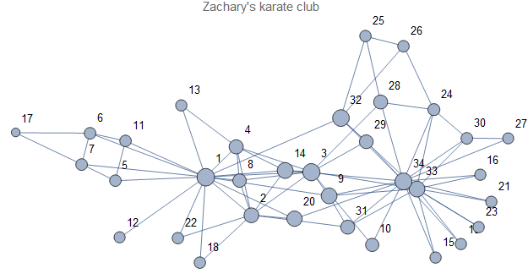
Centrality measures
How „important” is a node/link?
degree
clustering
closeness
betweenness
…
MEJ Newman, The Structure and Function of Complex Networks, SIAM REVIEW 45 (2003) 167–256

Slide 46
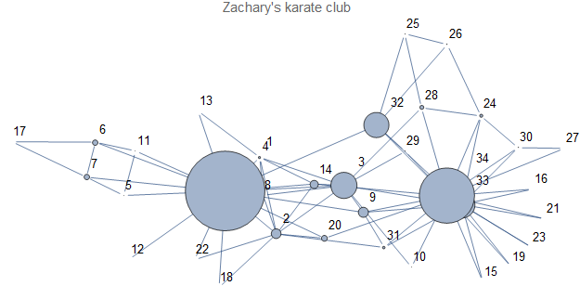
Centrality measures
How „important” is a node/link?
degree
clustering
closeness
betweenness
…
MEJ Newman, The Structure and Function of Complex Networks, SIAM REVIEW 45 (2003) 167–256

Slide 47
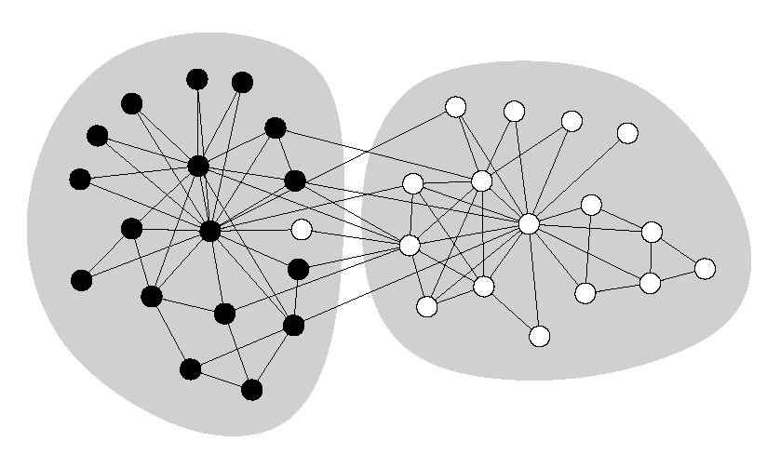
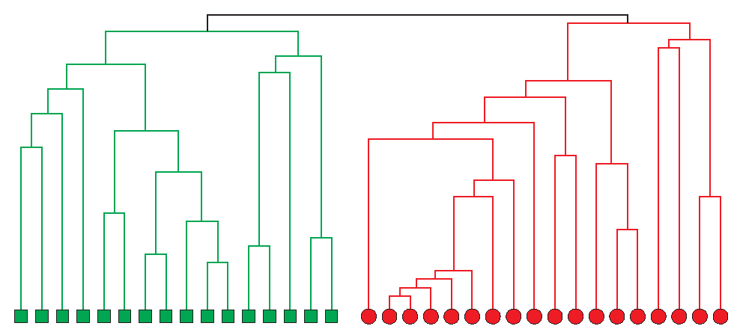
Community detection (clustering)
MEJ Newman, The Structure and Function of Complex Networks, SIAM REVIEW 45 (2003) 167–256
MEJ Newman, Communities, modules and large-scale structure in networks, Nature physics, 8 (2012) 25

Slide 48
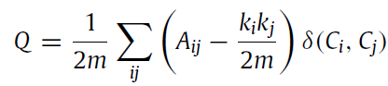
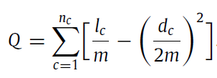
Community detection (clustering)
 | Nodes
Nodes |  |  | 1
 |  |  | 1 |  | 1
 | 1 | 1 |  | 1 |  | 1
 |  |  | 1 |  | 1 | 1
 |  | 1 |  | 1
 |  |  | 1 | 1
S Fortunato, Community detection in graphs, Physics Reports 486 (2010) 75-174

Slide 49
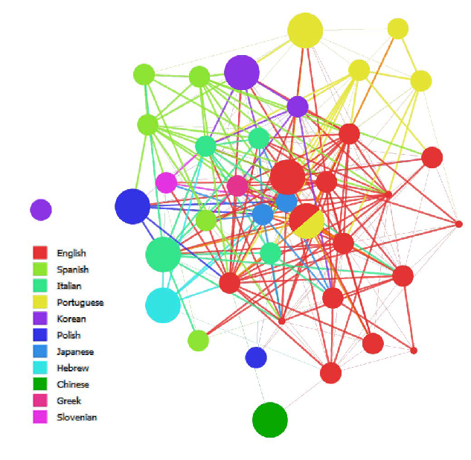
Example: SLA interactions
branches= clusters
node size= improvement

Slide 50
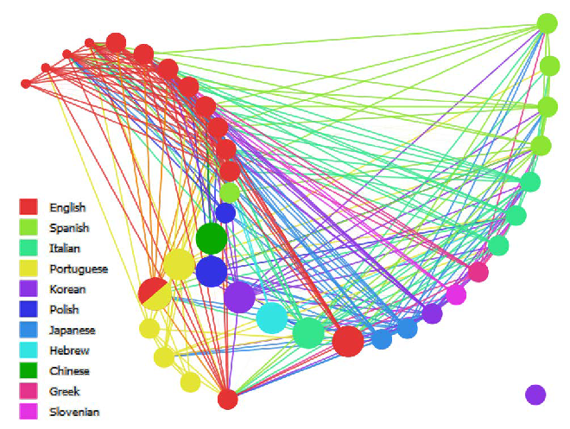
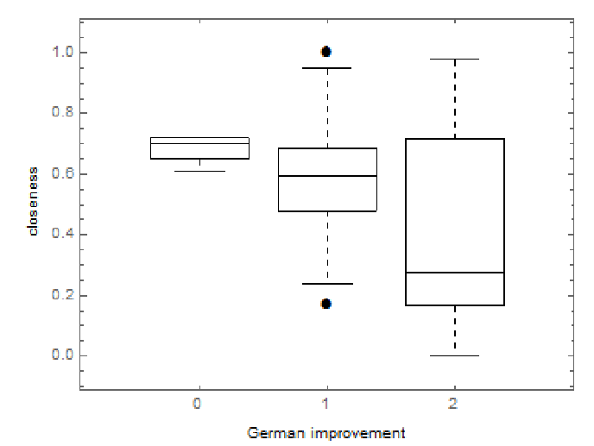
Example: SLA interactions
branches= clusters
node size= improvement

Slide 51
Data collection

Slide 52
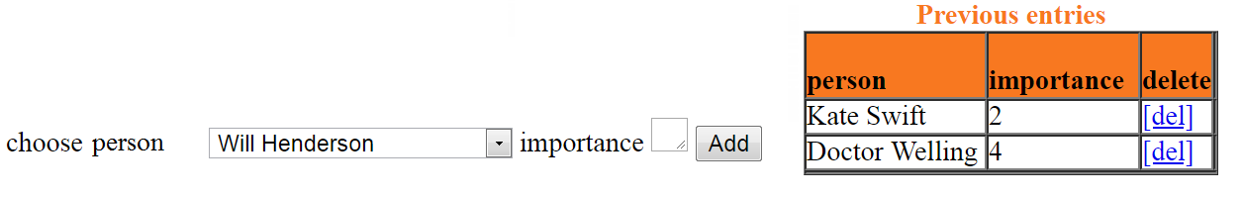
Our proprietary network extractor: a tool to annotate relations while preserving the temporal frame, in PHP and MySQL. The goal of using this app is to investigate temporality of contacts on propagation processes.
MOODLE: a flexible and adaptable tool for distance learning. The Survey module provides a number of instruments allowing for the preparation of questions customised for every respondent, e.g. asking about their contacts with others
EgoWeb 2.0: an open-source platform for conducting online and face-to-face surveys to gather ego-centred network data. Created in the US to understand smoking behaviour.
ANAMIA Egocenter: an open-source web survey allowing participant-generated sociograms. It was used to study users of websites on eating disorders.

Slide 53
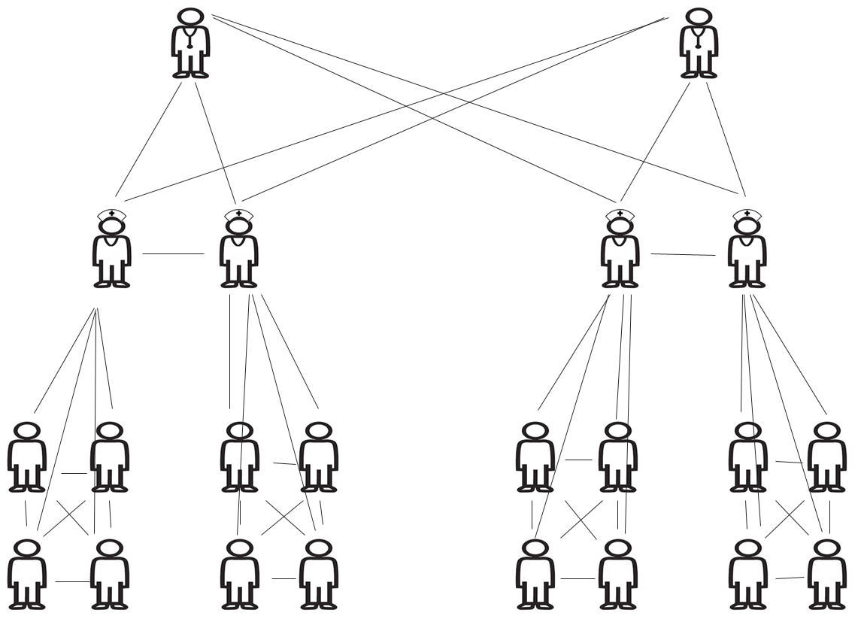
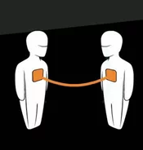
Theoretical
Empirical

Slide 54
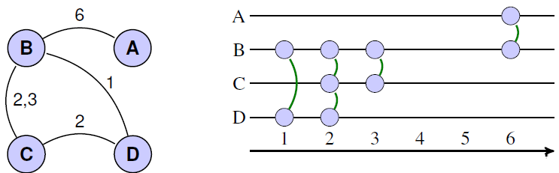
Temporal aspects

Slide 55
Ego-centric networks form survey contact data in Poland (~10000 participants)
Day i-1 Day i Day i+1
5
1
1
1
2
6
4
2
2
4
3
5
3
Daily
3
Rare
Random
Ego
> 4h
1h< <4h
15m< <60min
5min< <15min
<5min

Slide 56
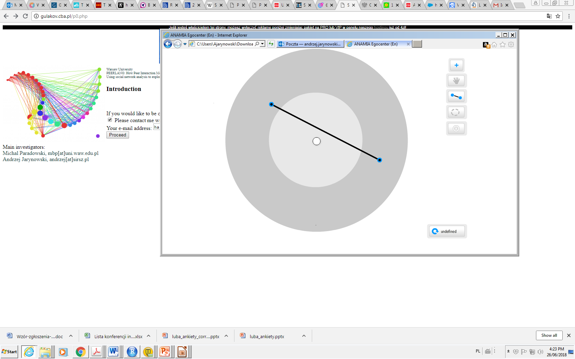
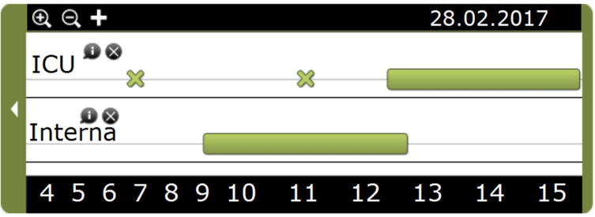
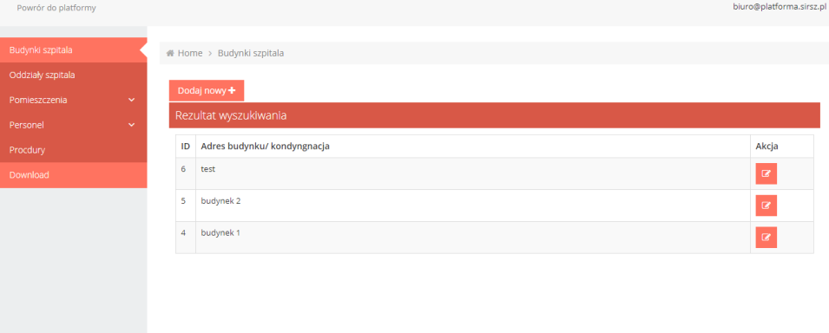

Slide 57

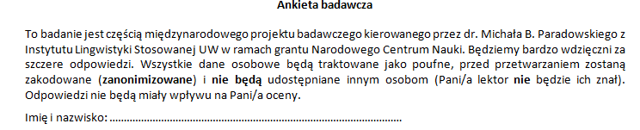

Slide 58
Notes:
Już niemożliwe do ściągnięcia z fb

